Slide 1
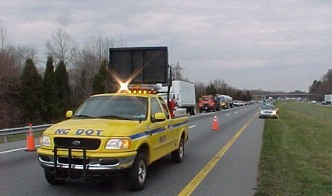
Lesson 5: Scene Safety

Slide 2
Lesson Objectives
Lesson 5
At the conclusion of this lesson, participants will be able to:
Describe how emergency vehicle markings can improve scene safety
Describe recommendations for emergency-vehicle lighting as set forth in the MUTCD
Describe high-visibility safety apparel requirements for incident responders

Slide 3
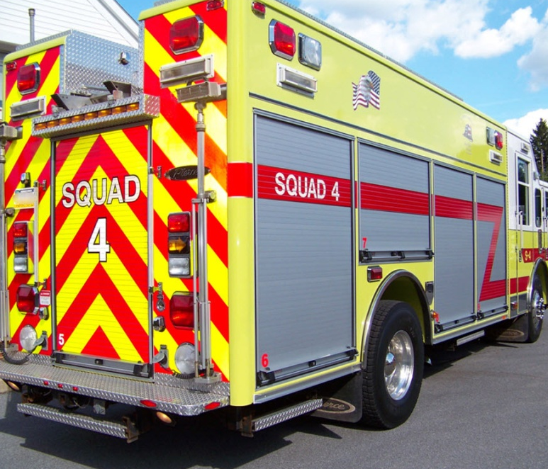
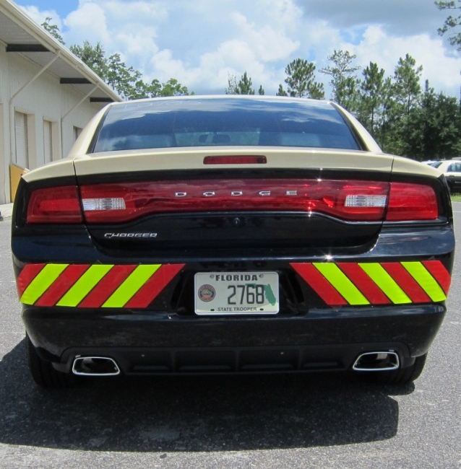
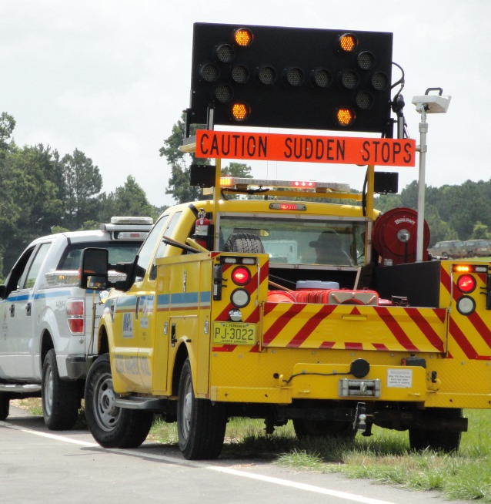
Emergency Vehicle Markings
Lesson 5
Notes:
Making responder vehicles more visible improves safety by reducing the chances they will be hit at incident scenes
The term conspicuity refers to the ability of a vehicle to draw attention to its presence, even when other road users are not actively looking for it
The Emergency Vehicle Lighting and Conspicuity Study was published in 2009 and is available online
Study reports on research done by the Federal Emergency Management Agency (FEMA) and the US Fire Administration (USFA) with support from the US Department of Justice (DOJ) and the National Institute of Justice (NIJ)
Markings are referred to as passive treatments that complement emergency lighting
Contrasting colors make the vehicle stand out
Fluorescent colors increase daytime visibility
Retro-reflective materials maximize nighttime visibility

Slide 4
National Fire Protection Association (NFPA) Standards
Lesson 5
NFPA1901 – Standard for Automotive Fire Apparatus (2009)
NFPA 1917 – Standard for Automotive Ambulances (2013)
At least 50% of the rear vertical surfaces of the apparatus shall be equipped with 6 inch (minimum) retroreflective striping, alternating yellow and red, in a chevron pattern sloping downward and away from the centerline of the vehicle at an angle of 45°
Notes:
National Fire Protection Association (NFPA) Standard 1901 governs the application of retro-reflective markings on fire apparatus
NFPA 1901 is the Standard for all automotive fire apparatus built on or after January, 2009
Standard requires 50% of the rear of the fire vehicle have minimum 6 inch striping placed at 45 degree angle down and away from centerline
Striping pattern is referred to as chevrons
Standard requires red, yellow, or hi-visibility green/yellow
Additional new NFPA Standard 1917, released in 2013, includes similar retro-reflective striping requirements for ambulances
There is no standard for other disciplines; law enforcement vehicles, DOT vehicles, Safety Service Patrol vehicles, or towing and recovery vehicles

Slide 5
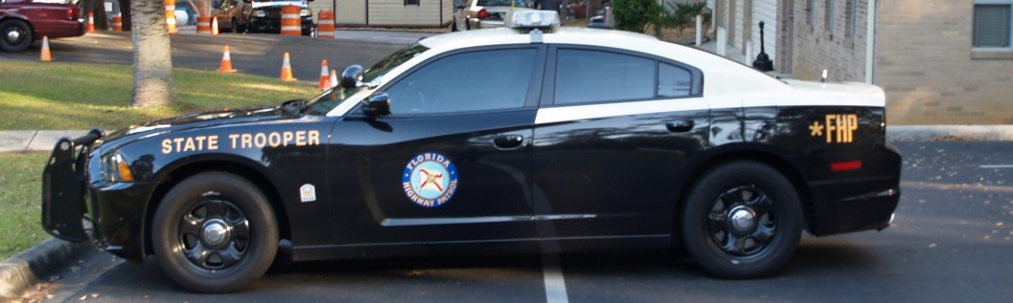
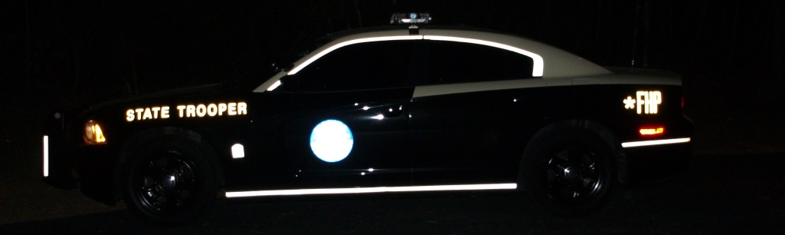
Law Enforcement Vehicle Markings
Lesson 5
Notes:
Unlike fire apparatus and ambulances, there is no standard for law enforcement vehicle markings in the United States
Increasingly, police departments are using high-visibility markings on their vehicles
Pictured is a patrol car with contour markings to silhouette the outline of the vehicle when viewed from the side
The Emergency Vehicle Lighting and Conspicuity Study acknowledged that law enforcement vehicles may have a need for stealth
Recommendation for law enforcement is to concentrate markings on the rear of the vehicle
Challenge for law enforcement are vehicle contours, large rear glass surface area, and minimal vertical surfaces on the rear of vehicles

Slide 6
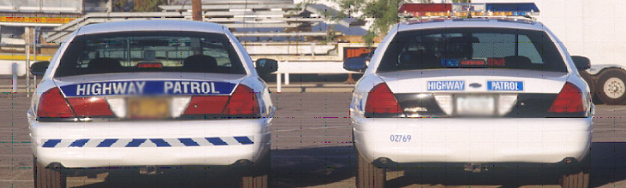
Law Enforcement Vehicle Markings – New Vs. Old
Lesson 5
Notes:
Retro-reflective markings increase nighttime conspicuity
Highlight the large lettering billboard effect and the addition of red reflective material next to the taillights
New lettering, chevrons, and red reflective materials were a vast improvement over the older markings shown on the right
According to research, however, the use of high-visibility red, green, or yellow/green fluorescent colors is essential to daytime conspicuity

Slide 7
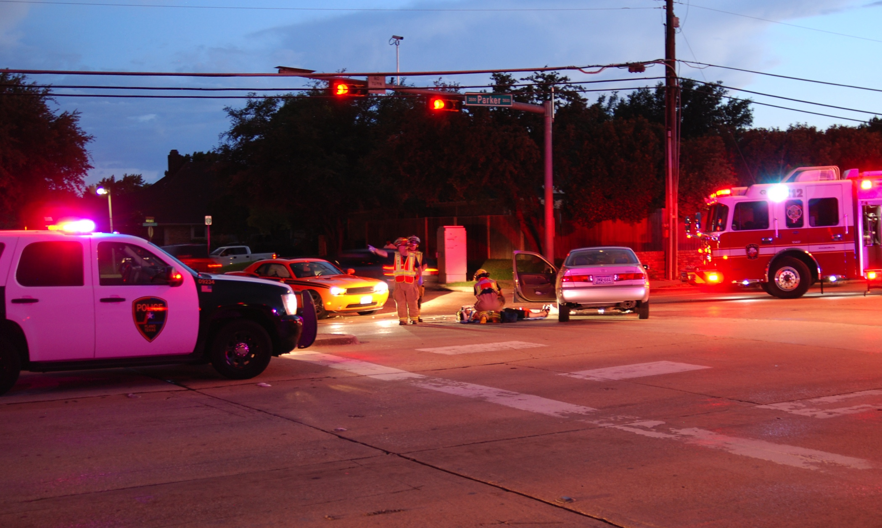
Emergency-Vehicle Lighting
Lesson 5
Notes:
MUTCD Section 6I.05 specifically covers the use of emergency-vehicle lighting and states:
The use of emergency-vehicle lighting (such as high-intensity rotating, flashing, oscillating, or strobe lights) is essential, especially in the initial stages of a traffic incident, for the safety of emergency responders and persons involved in the traffic incident, as well as road users approaching the traffic incident

Slide 8
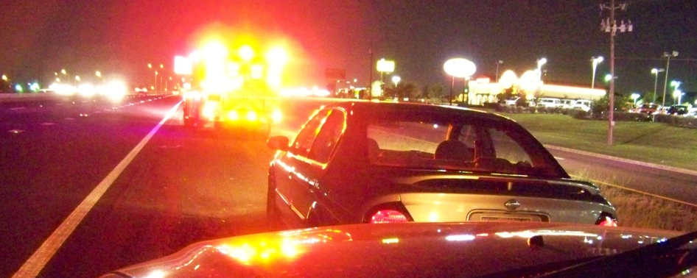
MUTCD Section 6I.05 – Use of Emergency-Vehicle Lighting
Lesson 5
Though essential for safety, use of too many lights at an incident scene can be distracting and can create confusion for approaching road users
Notes:
Emphasize here that more is not always better where emergency lighting is concerned
Too many lights can be distracting or even worse blinding to approaching motorists
Lighting technology has advanced significantly in recent decades
LEDs make more efficient and compact units for public safety applications
The MUTCD specifically states that emergency-vehicle lighting provides warning only and provides no effective traffic control
Most lighting has the effect of look at me or watch out, I am here rather than guiding approaching drivers
Vehicle lighting needs to warn drivers but not overload their senses
Some red and blue emergency lights are beneficial to promote warning and Move Over Law compliance
Reducing some lights when multiple responders are on scene eliminates a blinding effect
According to the Emergency Vehicle Lighting and Conspicuity Study, there is no research to support the moth effect where drivers are drawn into lights

Slide 9
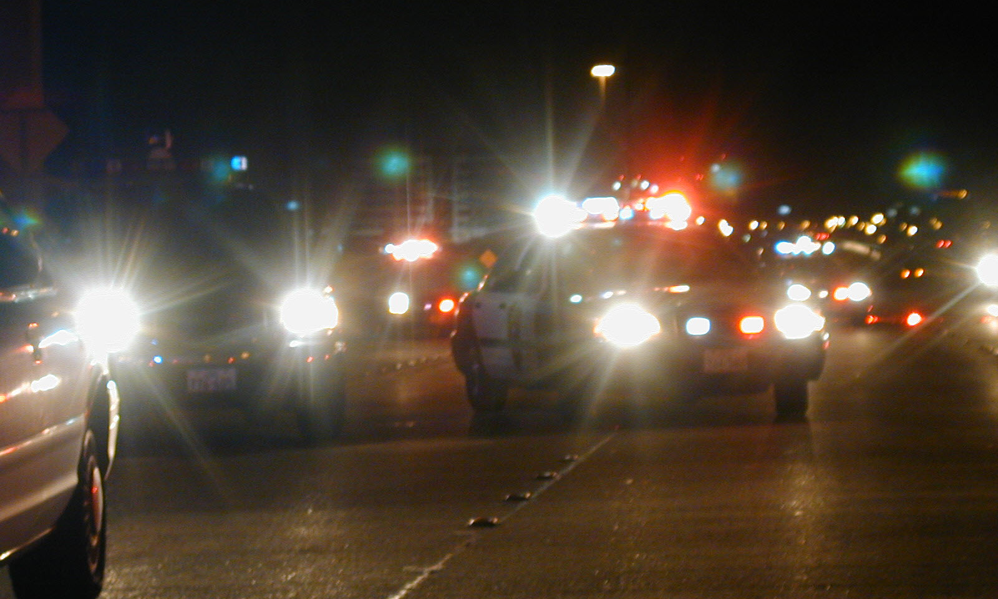
MUTCD Section 6I.05 – Use of Emergency-Vehicle Lighting
Lesson 5
Notes:
MUTCD Section 6I.05 (continued):
The use of too many lights at an incident scene can be distracting and can create confusion for approaching road users (and other responders), especially at night
Reducing forward-facing lights is another important part of TIM
Forward-facing lights distract traffic traveling in the opposite direction and create rubbernecker delays
Forward-facing lights can blind opposite direction vehicles
Forward-facing lights contribute to secondary crashes on opposite direction travel lanes
Most modern lighting systems allow forward lights to be turned OFF – ask participants if their agency has any vehicles that are not equipped with that capability

Slide 10
MUTCD Section 6I.05 – Use of Emergency-Vehicle Lighting
Lesson 5
Once good traffic control is established, the MUTCD recommends reducing the amount of emergency-vehicle lighting
Public safety agencies should examine their policies on the use of emergency-vehicle lighting with the intent of reducing the use of this lighting as much as possible while not endangering those at the scene
Notes:
MUTCD Section 6I.05 (continued):
The use of emergency-vehicle lighting can be reduced if good traffic control has been established at a traffic incident scene
When multiple responder vehicles are present, only the rear-most(upstream) vehicles and blocking vehicles should continue the use of emergency (warning) lights after appropriate traffic control is in place
Policy guidance might include:
Reducing the use of emergency-vehicle lighting as much as possible while not endangering those at the scene
Reducing or extinguishing forward facing emergency-vehicle lighting, especially on divided roadways, to reduce distractions to oncoming road users
Vehicle headlights, any floodlights or vehicle headlights that are not needed for illumination, or to provide notice to other road users of an incident response vehicle being in an unexpected location, should be turned off at night
To support the recommendations set forth in the MUTCD, agencies should also consider installing day/night or high/low power switches on LED and strobe bars

Slide 11
Responder Visibility
Lesson 5
MUTCD Section 6D.03 states:
All workers, including emergency responders, within the right-of-way of a roadway who are exposed either to traffic (vehicles using the highway for purposes of travel) or to work vehicles and construction equipment SHALL wear high-visibility safety apparel…
Notes:
As discussed previously, the MUTCD applies to all streets and highways open to public travel
This requirement applies to all incident responders, including, but not limited to:
Law enforcement
Fire
EMS
Towing and recovery
Medical examiner/Coroner
Local/county/state maintenance and transportation officials
Insurance investigators
Traffic engineers
Media personnel
The Code of Federal Regulations (23 CFR Part 634) implemented a high-visibility safety apparel requirement for Federal Aid Highways in November of 2008
The 2009 MUTCD supersedes 23 CFR and applies the high-visibility safety apparel requirement to all roadways

Slide 12
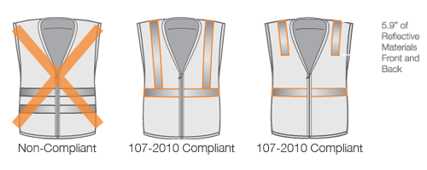
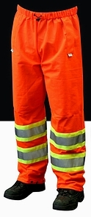
Emergency Responder High-Visibility Safety Apparel
Lesson 5
Must meet, and be labeled as meeting one of two standards:
ANSI/ISEA 107, Standard Performance for:
Class II
Class III
ANSI/ISEA 207, Public Safety Vests
Notes:
Prop: Recommend having examples of Class II, Class III, and Public Safety (with breakaway) vests
ANSI 107-2010 Classes
Class 1- Minimum protection, parking lot
Class 2- Greater visibility, close proximity to vehicular traffic
Class 3- Higher vehicle speeds, reduced sight distance, must be conspicuous through a full range of motions
Class E- Jackets, coveralls, bib overalls and trousers
ANSI 107-2010 Design & Materials
Garment design & reflective placement
Flame Resistant (FR) labeling
Rainwear – three test; water repellant, water resistant, or water proof
Garment Service Life – type of garment, environment, laundering methods, and exposure to environment
ANSI 207-2011 (EMS, Fire and Law Enforcement) – differences;
Shoulder design
Vest dimensions (e.g. shorter vests)
Color back panels – red for FIRE, blue for LAW ENFORCEMENT, green for EMS, and orange for DOT
Identification clarity for lettering, logos, and ID panels

Slide 13
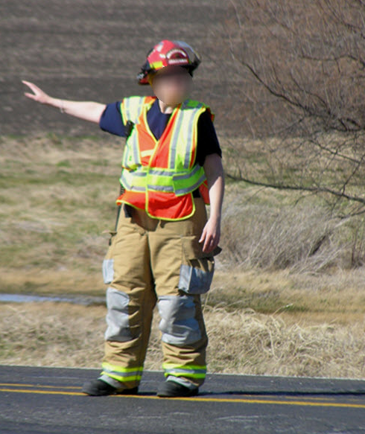
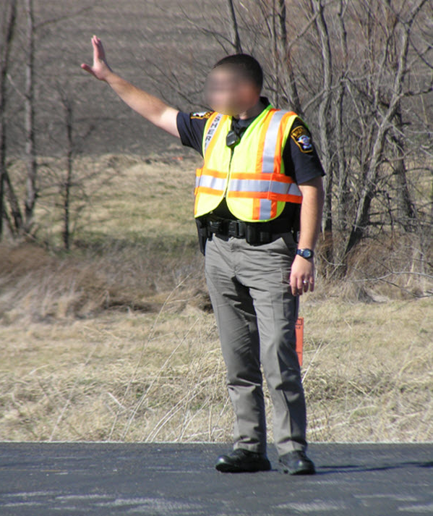
ANSI 107 vs. ANSI 207
Lesson 5
ANSI 107 Class II Vest
ANSI 207 Public Safety Vest
Note shorter length to allow access to items on belt
Notes:
Animation: Click forward to make the text box appear
The ANSI 207 standard includes basic requirements such as vest dimensions, color, and materials performance
The five-point breakaway function is also available for ANSI 107 and 207 standard vests [Demo if vest is available]
Vests may also have badge holders, pen holders, microphone holders, and other accessories beneficial to responders

Slide 14
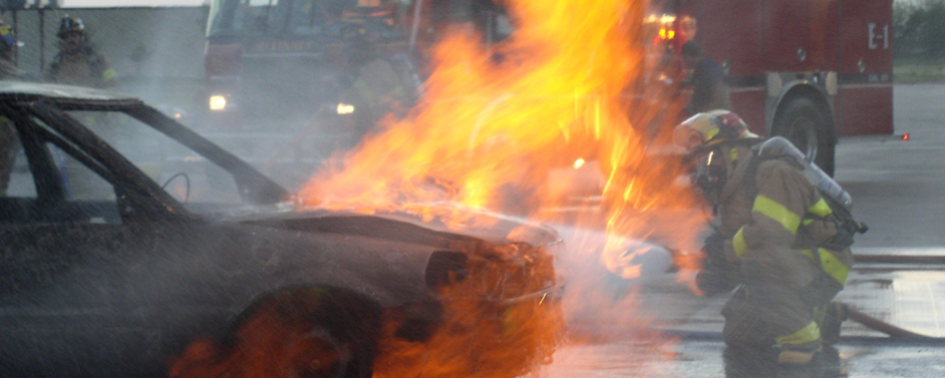
MUTCD Section 6D.03 Exceptions
Lesson 5
Firefighters or other responders engaged in emergency operations that directly expose them to flame, fire, heat, and/or hazardous materials
Notes:
Firefighters are exempt from MUTCD high-visibility safety apparel requirements when they are engaged in any activity that directly exposes them to flame, fire, heat and/or hazardous materials
Other firefighters on the scene, such as the pump operator and the supervising officer, are required to comply with the requirement if not exposed to fire, etc.

Slide 15
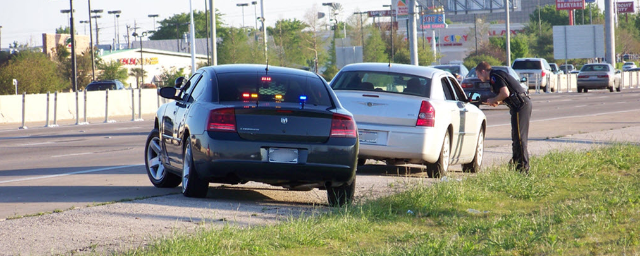
MUTCD Section 6D.03 Exceptions
Lesson 5
Law enforcement when actively engaged in potentially confrontational law enforcement activities (i.e., tactical operations)
Notes:
Law enforcement personnel are exempt from MUTCD high-visibility safety apparel requirements when engaged in potentially confrontational law enforcement activities such as traffic stops and searches, but are required to wear high-visibility apparel any other time they are afoot near a roadway:
Directing traffic
Investigating crashes
Handling lane closures, obstructed roadways, or disasters

Slide 16
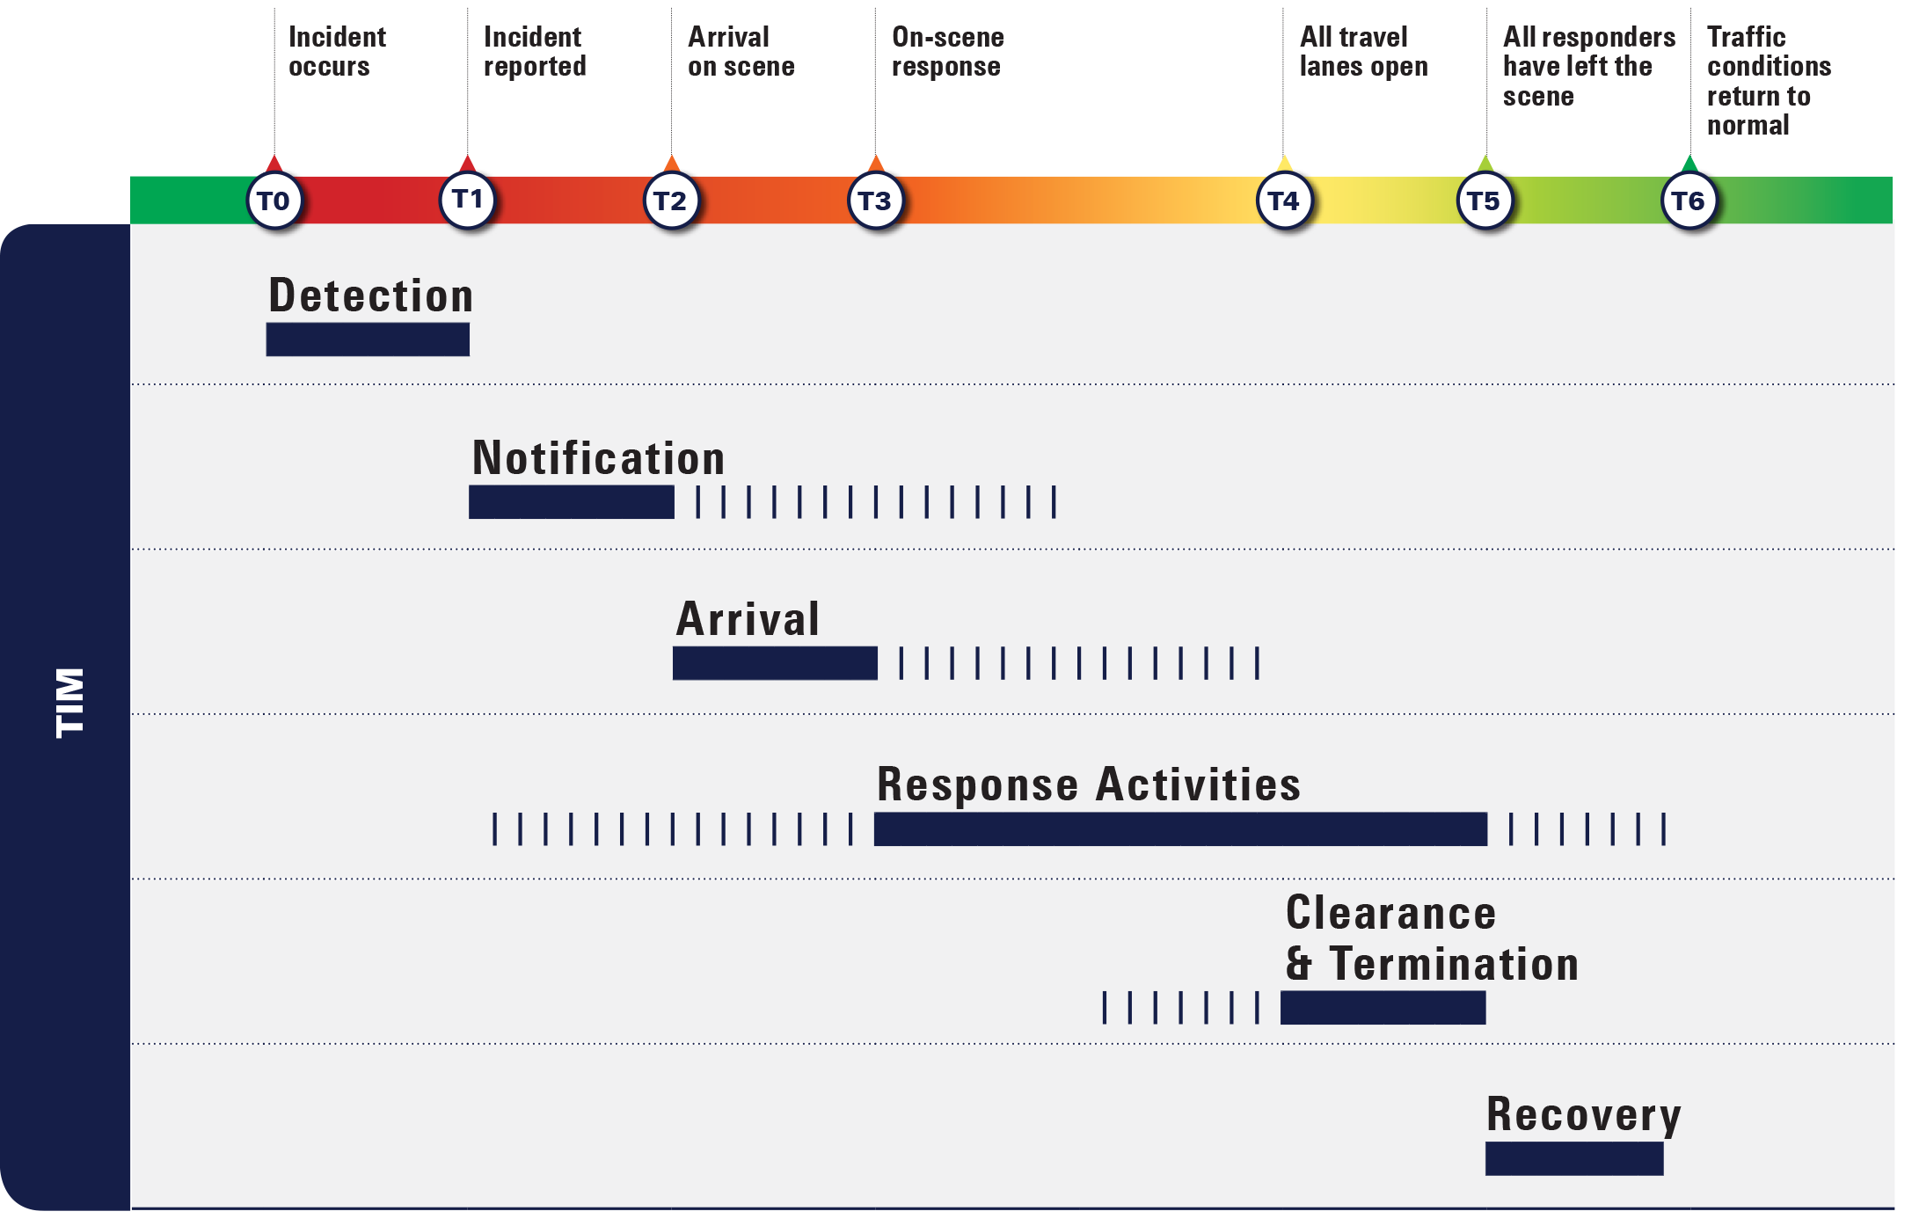
TIM Timeline
Lesson 5
Notes:
Animation: Click forward to make orange box appear and then click again to bring up detailed view of Response Activities
Ask/Discuss: How do emergency vehicle markings and emergency-vehicle lighting impact the TIM Timeline?
Highlight that scene safety is a critical and required component of effective TIM

Slide 17
Lesson 6: Command Responsibilities

Slide 18
Lesson Objectives
Lesson 6
At the conclusion of this lesson, participants will be able to:
Describe both the need and the requirements for establishing and participating in the Incident Command System (ICS)
Describe when it is appropriate to implement Unified Command
Identify the need for and use of Staging Areas

Slide 19
Incident Command System (ICS)
Lesson 6
Standardized, on-scene, all-hazards incident management concept
Allows users to adopt an organizational structure for handling an incident without being hindered by jurisdictional boundaries
Goals of ICS:
Safety of responders and others
Achievement of tactical objectives
Efficient use of resources
Notes:
Clearing incidents safely and quickly depends on developing coordinated, multi-agency operations that are supported by integrated communications
Coordination comes when all responders from all disciplines are trained and can effectively operate under the ICS at highway incidents
Like the NASCAR Pit Crew analogy, everyone works together under a coordinated system, knowing their role plus understanding the roles of their team members

Slide 20
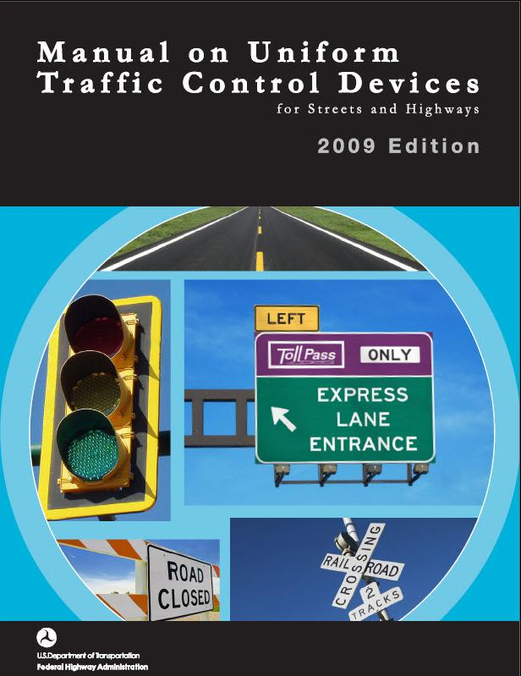
ICS and MUTCD Chapter 6I
Lesson 6
Section 6I.01 – General
The National Incident Management System (NIMS) requires the use of ICS at traffic incident management scenes
A traffic incident is an emergency road user occurrence, a natural disaster, or other unplanned event that affects or impedes the normal flow of traffic
Notes:
The NIMS requirement that ICS be used at traffic incident scenes is emphasized in MUTCD Section 6I.01
The National TIM Responder training course assumes that participants have already taken ICS 100, 200, and IS 700
The material in Lesson 6 is intended to simply be a review of the fundamental ICS information presented in these three online courses

Slide 21
Command Structures
Lesson 6
Single Command
Incident Commander has complete responsibility for incident management
Unified Command
Utilized when incidents require multi-jurisdictional or multi-agency response
Allows all agencies to:
Work together without affecting authority, responsibility, or accountability
Manage an incident together by establishing a common set of incident objectives and strategies
Notes:
When one individual is designated as Incident Commander, or the IC, that person represents the Single Command concept
Unified Command is a joint management and authority structure in which the role of Command is shared by two or more individuals
Unified Command typically is fulfilled by a team of individuals already having authority within their discipline or responding agency
Allows responding agencies and/or jurisdictions with responsibility for the incident to share incident management
May be needed and is most appropriate for major incidents involving multiple agencies

Slide 22
Incident Action Plan
Lesson 6
Unified Command must work together to implement an
Incident Action Plan
Notes:
Incident Action Plans (IAPs) are developed to identify tactical objectives and identify:
How the objectives will be accomplished
The resources needed to achieve those objectives
IAPs are often unwritten in small-scale incidents and recorded in a written format during larger-scale incidents
The IAP assigns resources to accomplish the tactical objectives and allots specified amounts of time to accomplish them
After the IAP is developed, on-going size-up occurs so that the IAP can be modified as necessary
The purpose of an IAP is to:
Record and document incident objectives
List and maintain a record of activities to be completed to address the objectives
Cover the operational period of an incident

Slide 23
ICS General and Command Staff
Lesson 6
Incident Commander
Information Officer
Safety Officer
Liaison Officer
Operation Section
Planning Section
Logistics Section
Finance/Admin Section
Notes:
Animation: First click forward turns the Information Officer box red and the second click turns the Safety Officer box red
The Command function is carried out by an Incident Commander or Unified Command
The Incident Commander is supported by a Command Staff and a General Staff
The Public Information Officer is responsible for: [First click]
Serving as the go-between for Command and the media
Relaying information on the incident and response efforts
The Safety Officer: [Second click]
Is responsible for monitoring scene safety and developing preventative safety measures
Possesses the ability to immediately stop any action that is deemed hazardous, unsafe, or too high a risk
All responders must adhere to immediate direction/orders from the Safety Officer
The Incident Commander can over-ride the Safety Officer’s orders after consultation with the Safety Officer and personnel involved in an action that was halted
The leaders of the individual sections are know as the General Staff and individually as Section Chiefs (can be any agency organizational rank)
Both the Command and General Staff report directly to the Incident Commander or Unified Command

Slide 24
Physical Organization
Lesson 6
Incident Command Post (ICP)
The field location at which the primary tactical-level, on-scene incident command functions are performed
Staging Area
Location established where resources can be placed while awaiting a tactical assignment
Notes:
Physical organization of a scene involves the establishment of a Traffic Incident Management Area, as well as an Incident Command Post, Staging Area(s), and diversion routes for larger-scale incidents
The Incident Command Post is where the Incident Commander or those participating in a Unified Command operation are physically located at the incident scene
An Incident Command Post should be established when ICS is initiated
Initially, it can be inside a responder’s radio-equipped vehicle
The Incident Command Post location should be communicated to responders as needed and clearly marked if possible
The Incident Commander/Unified Command team should be located at the Incident Command Post
Staging Areas allow for the organization of personnel and equipment to be readied for immediate use at the incident scene
Holding incoming resources that are not actively involved in incident operations
Consideration should be given to the location and whether there is enough room for large response vehicles to easily enter or exit the staging area
Staging Areas also allow for un-needed resources and/or personnel to immediately depart the scene and return to service

Slide 25
Case Study
Lesson 6
Notes:
Video: L6_V1 - MO On-Scene Arrest.wmv
Following is a synopsis of the video:
One of the LE Officers on the scene has an issue with where the fire engine has been parked and walks over to the engine and tells the FD driver to move
The FD driver refuses to move the engine because his Captain directed him to park within Lane 2
The LE Officer approaches the FD Captain who is working on getting the injured motorist out of the vehicle
The FD Captain tells the engine driver not to move the vehicle
This confrontational situation leads the LE Officer to place the FD Captain into custody while he is supporting the head of the patient
Ask/Discuss: Was ICS followed?
Ask/Discuss: If ICS had been used, how could this incident have turned out differently?

Slide 26
Case Study
Lesson 6
Notes:
Ask/Discuss: In terms of both the second arriving LE unit and FD engine, was the positioning of these vehicles appropriate or could it have been improved? If so, how?
The FD engine could have parked behind the LE as there was already a Lane +1 block in place
Additional considerations:
The way the FD Captain exited the engine is unsafe, not a recommended practice, and violates common safety protocols within the Fire Service
There was a long running personality clash between the LE Officer and the FD Captain

Slide 27
TIM Timeline
Lesson 6
Notes:
Animation: Click forward to make orange box appear and then click again to bring up detailed view of Response Activities
Ask/Discuss: How could the effective use of ICS impact the TIM Timeline?
Highlight that ICS should be established at every incident scene as soon as the first responder arrives on-scene

